Slide 1



TUMOR
TRACE
By
Katta Sai Rutvik
kattasairutvik@gmail.com

Slide 2




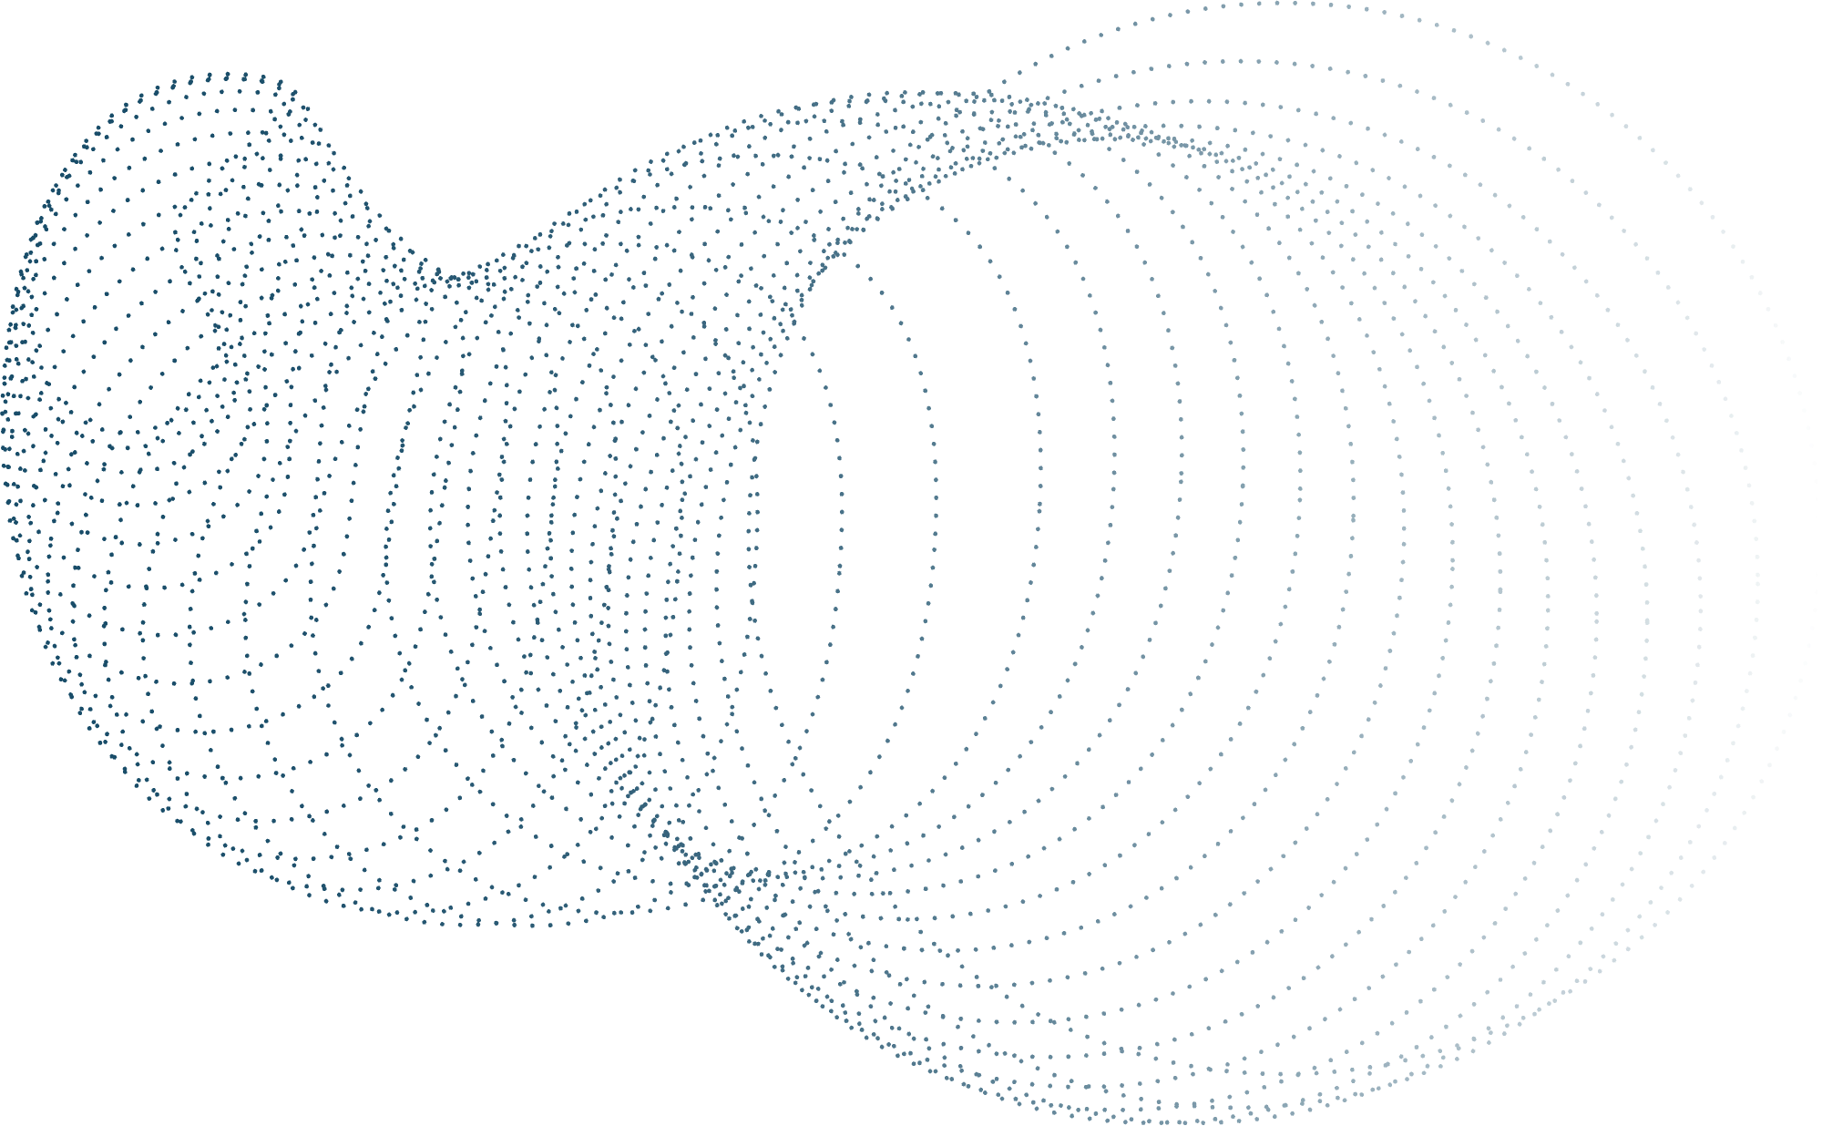
Table of Content
Problem Statement
Dataset
Pre Processing
Flow Diagram
Training
Testing and Results
Gradio implementation

Slide 3
Problem Statement
Dataset
Preprocessing
Flow Diagram
Training
Problem Statement
This project aims to address these challenges by leveraging Artificial Intelligence (AI), specifically deep learning techniques, to automate the detection and classification of breast tumors in MRI scans.
By integrating AI-based models like VGG16, ResNet50, and ResNet18, the project seeks to enhance diagnostic accuracy, reduce manual effort, and support radiologists with reliable predictions for distinguishing between benign and malignant tumors.

Slide 4
Problem Statement
Dataset
Preprocessing
Flow Diagram
Training
Data Set
The dataset used in this project is specifically curated for breast tumor detection and classification using MRI images. It is divided into three subsets: training, validation, and testing.
The training set is used to teach the model patterns associated with benign (non-cancerous) and malignant (cancerous) tumors. The validation set helps in fine-tuning hyperparameters and monitoring the model’s performance during training, while the test set evaluates the model’s ability to generalize to new, unseen data.

Slide 5
Problem Statement
Dataset
Preprocessing
Flow Diagram
Training
Preprocessing
Involves several steps to prepare the MRI images for effective training and ensure consistency in the dataset. All images are resized to a uniform dimension of 224x224 pixels to standardize input size. Normalization is applied using ImageNet’s mean and standard deviation to scale pixel values and facilitate faster model convergence.
Data Augmentation:
• Random horizontal and vertical flips with a 50% probability.
• Random rotations within a range of -20° to +20°.
• Color jitter to adjust brightness, contrast, saturation, and hue.

Slide 6
Problem Statement
Dataset
Preprocessing
Flow Diagram
Training
Preprocessing
• Sobel edge detection is applied to highlight significant boundaries in the images.
• Feature Extraction:
• Histogram of Oriented Gradients (HOG): Captures structural and shape information.
• Local Binary Pattern (LBP): Encodes local texture features.
• Mean Binary Pattern (MBP): Evaluates pixel patterns based on the mean intensity of a local window.
• Median Binary Pattern: Encodes patterns using the median intensity of a local window.
• Variance Binary Point: Uses variance within a local window to compute binary patterns.
•Mean-Median-Variance (MMV): Combines mean, median, and variance thresholds to extract comprehensive binary patterns.

Slide 7
Dataset Collection & Preprocessing
Problem Statement
Dataset
Preprocessing
Flow Diagram
Training
Model Training
Testing & Evaluation
Gradio Deployment

Slide 8
Problem Statement
Dataset
Preprocessing
Flow Diagram
Training
Model Initialization
• Selected deep learning models ( VGG16, ResNet50, ResNet18).
• Modified the model architecture for binary classification (Benign vs. Malignant).
• Freeze feature extraction layers to train only the classifier layers.
Data Loading & Batching
• Load preprocessed training data in batches using PyTorch DataLoader.
Batch size is taken as 32.
.
Model Training
• Trained the model using CrossEntropyLoss as the loss function.
• Used optimizers like Adam ,SGD to minimize the loss.
• Performed backpropagation to update the model weights.

Slide 9
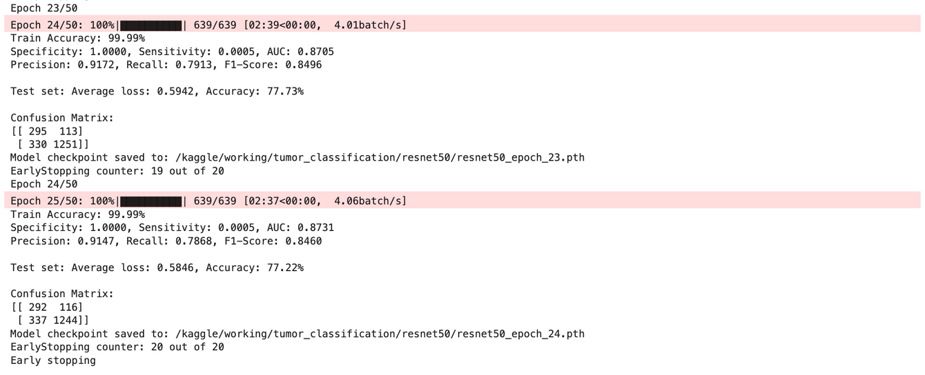
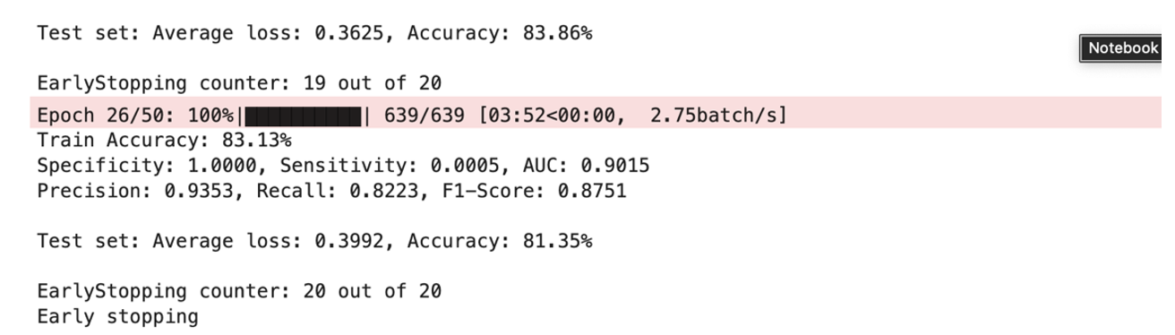
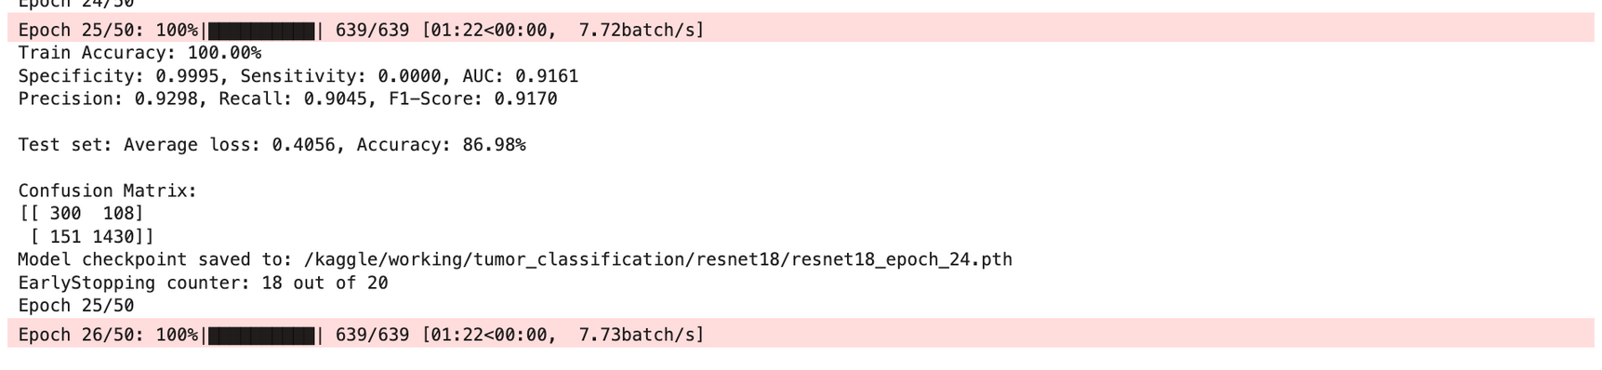
Problem Statement
Dataset
Preprocessing
Flow Diagram
Training

Slide 10
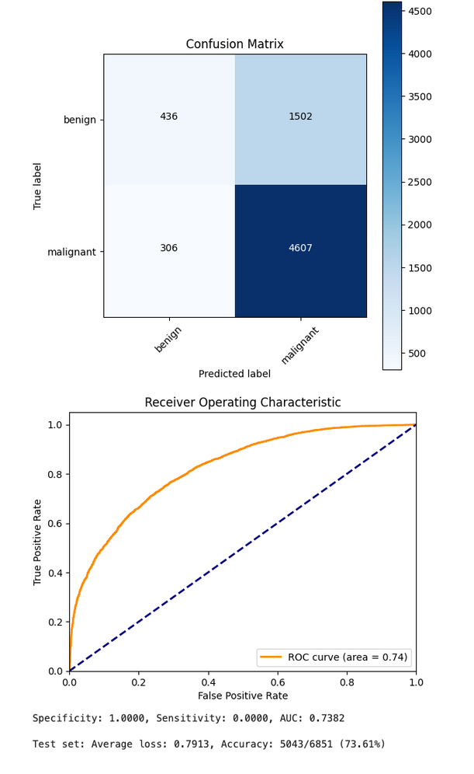
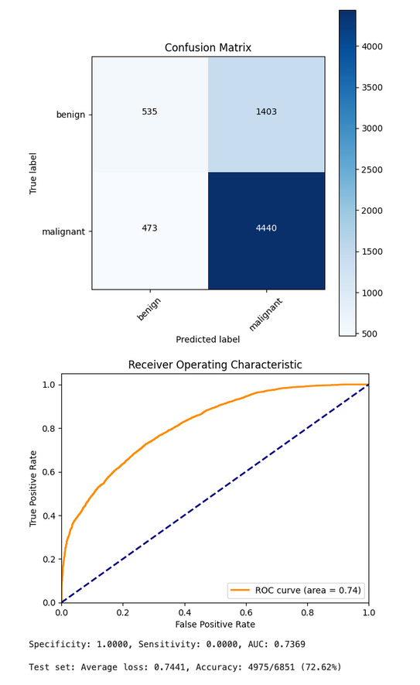
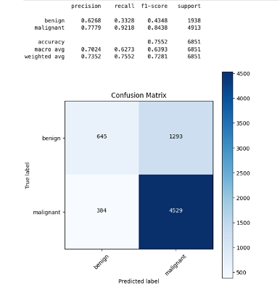
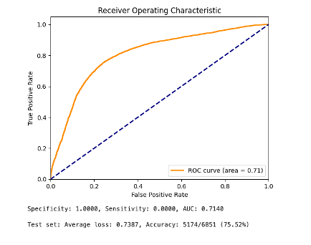
Testing and Results
RESENET50
RESENET18
VGG16

Slide 11

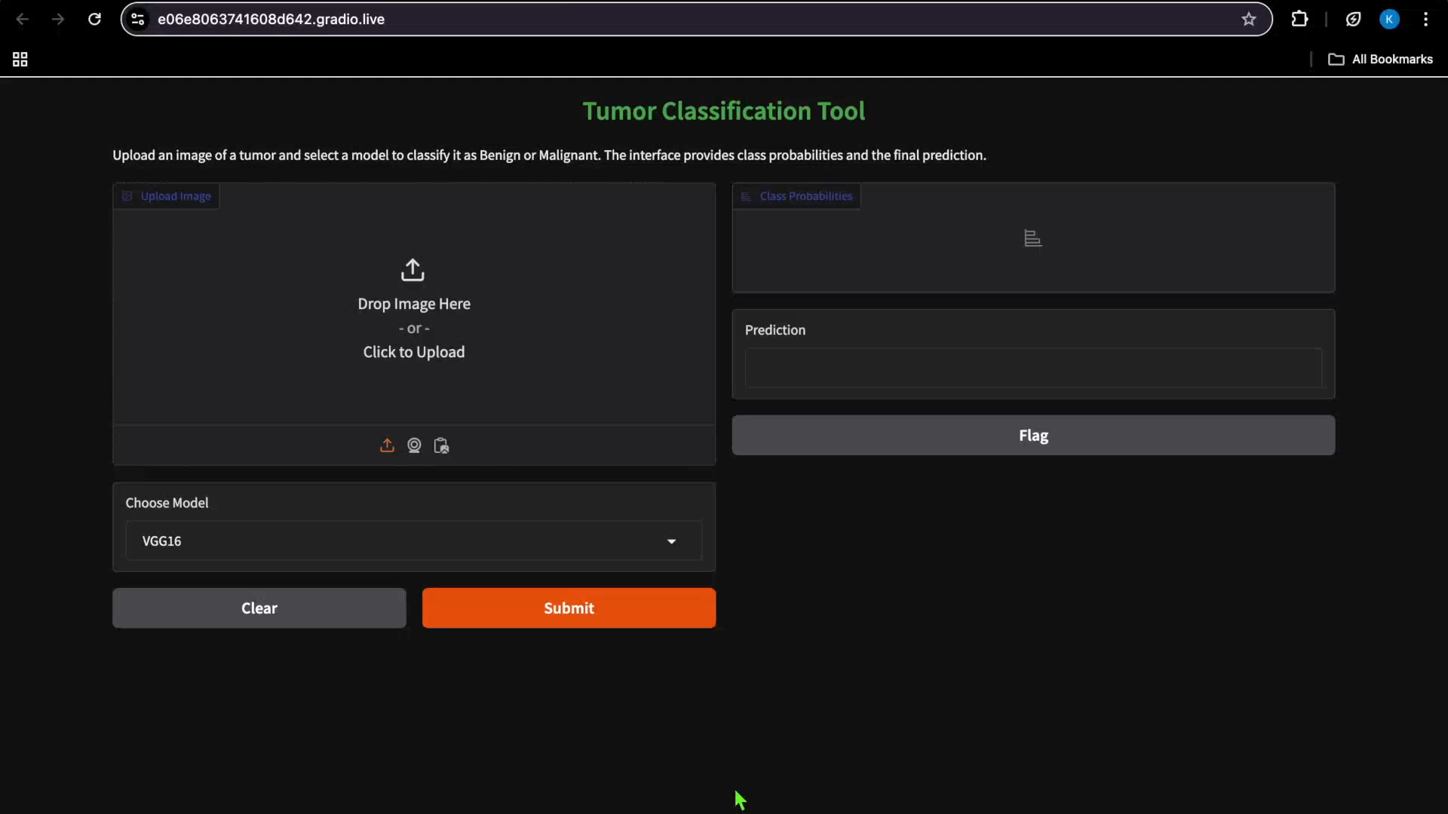
GRADIO
Click here to access Drive link for the video
https://drive.google.com/file/d/11ht-pzUw0-UVsDEjfrOfHMmr55l49B4F/view?usp=drive_link

Slide 12
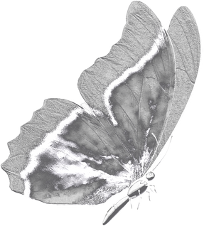
THANK
YOU

